Slide 1
Financial Overview
For Seattle Colleges Board of Trustees
Study Session
May 10, 2018
By
Jennifer Howard
Interim Vice Chancellor of Administrative Services

Slide 2
4 College Budgets
Operating budget:
  The budget that funds regular operations, funded by state allocation and local funds.
Capital budget:
  The budget that funds construction and large repairs, funded by state capital budget funds and some local funds.
Grants/contracts budgets:
  The budgets that spend the funds we receive for performing particular work, based on the grant/contract.
Enterprise funds (parking, cafeteria):
  Programs that generate revenue that (for the most part) covers the expenses of the program, and may generate profit that can be used for projects, or reinvested in the program.

Slide 3
State allocation
Legislatively approved
Use it or lose it. Unspent allocation goes back to the state June 30 each year.
Distributed by SBCTC to districts/colleges based on:
  Enrollments (hitting the target for FTES, and weighted FTES for identified courses)
  Student Achievement (basic skills gains, completion, retention)
  Minimum operating allowance
  Stop/Loss (also known as ‘hold harmless’ which eases the impact of reductions over 4 years)

Slide 4
Local funds
Revenue sourced locally
  Revenue that comes in during the fiscal year
  Anticipated revenue balances the forecasted budget
    May or may not come in as projected
    Need to budget conservatively in forecasting local fund revenues
Consists of
    tuition
    Running Start funds
    international funds
    Fees
    Other (room rentals, contracts, etc.)

Slide 5
Reserves (a.k.a. fund balance, cash balance)
One time use funds @ $98,013,485 as of July 1, 2017
Generated locally over time
Controlled locally
  One time money
    No reliable on-going source for adding to reserves
    Once spent, it is no more
Most people won’t use savings to pay their monthly mortgages.

Slide 6
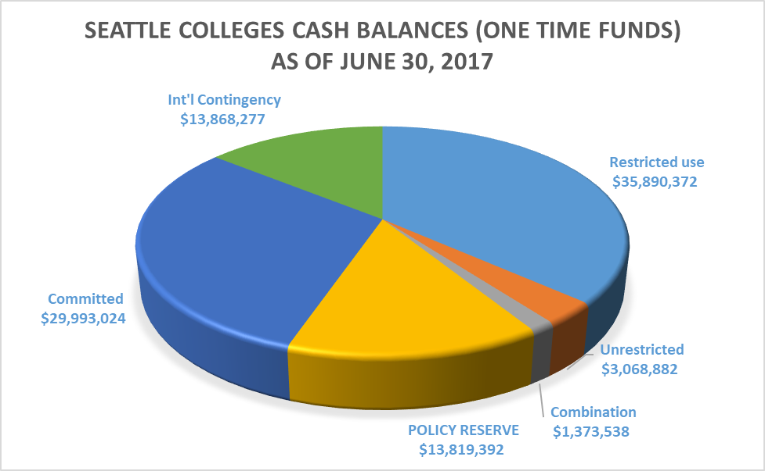

Slide 7
Policy Reserve $13,819,392
The Board Policy requires that the Colleges reserve 5-10% of expenditures.*
The Board approved the 2017-18 Fiscal Year Budget totaling $194,560,902.
The policy reserve is 7.1% of expenditures as budgeted for 17/18.
*Seattle Colleges Board Policy 608: “Seattle Colleges will establish and maintain a reserve of 5-10% of the aggregate total of each fund’s annual expenditure budget.”

Slide 8
Committed Reserves $29,993,024
These reserves are committed for:
projected tuition and state allocation shortfalls (ex: low enrollments; allocation stop/loss)
planned local capital projects that are not state funded
classroom and other large one-time infrastructure needs/repairs
covering costs for programs that have accumulated deficits
high-cost instructional equipment needs/maintenance
off-campus apprenticeship programs
other projects / innovation

Slide 9
International Contingency $13,868,277
Of the $130 million in the core operating budget, $16 million of that is international revenue
Unexpected external factors could impact our international revenue. (ex: change in immigration policy, swine flu)
This contingency is a bridge to be used in case international revenues drop rapidly, so that we can fulfill commitments as we readjust budgets.

Slide 10
Legally Restricted Reserves $35,890,372
State law prohibits the colleges from using these funds for any purpose other than the one for which they are intended.
Examples include:
  Student Activity funds
  Class / Lab Fees
  Funds held in trusts
  Financial Aid funds
  Capital accounts

Slide 11
Unrestricted $3,068,882
Unrestricted funds are available to be used for specific purposes by the Board of Trustees or Chancellor.

Slide 12
Combination $1,373,538
This category is for some grant funds that allow some flexibility of use.
They are for a specific purpose, but do not work as a regular ‘cost reimbursement’ grant.

Slide 13
Why have reserves at all?
Continuity of operations
  Legislative delay in establishing a budget, requires colleges to ‘cover’, or shut down, July 1.
  Disaster preparedness, so that the colleges could maintain core services and not shut down
Reduced state funding
  State funding for Seattle Colleges has been reduced significantly. This makes it challenging to innovate, explore new programs and maintain facilities and equipment. Reserves can help fill the gap.
Unfunded & underfunded capital projects
  Little state funding for large-scale capital projects. Reserves can fund capital projects, including new buildings and large-scale renovations.
  Capital projects are funded below the cost to build. Using reserves avoids changing building plans to meet lower funding amounts.

Slide 14
General take-away points
Under the 2016 allocation model, Seattle ended up with a significant reduction of base state allocation. Seattle’s reduction has been just over $900,000 each year for the last three years, with a fourth year reduction expected in 19/20.
Because allocation accounts for only a part of the revenue for the colleges, the other revenue comes from local funds. Local funds are used to run college operations.
Reserves are one-time money that is, at times, used to balance a budget while a college is in transition, or to fill a budget gap on a temporary basis.
It is not fiscally responsible to use one-time money to cover ongoing costs over the long term.

Slide 15
State Allocation

Slide 16
Washington State Budget biennium: 2018/19

Slide 17
2017/18
SBCTC legislative appropriation $734,811,000
Capital funding in MOA $11,400,000
TOTAL LEGISLATIVE APPROPRIATION $746,211,000
Less SBCTC operations: $26,950,000
AMOUNT AVAILABLE FOR SYSTEM ALLOCATION:
$719,261,000
2018/19
SBCTC legislative appropriation $757,406,000
Capital funding in MOA $11,400,000
TOTAL LEGISLATIVE APPROPRIATION $768,806,000
Less SBCTC operations: $27,539,641
AMOUNT AVAILABLE FOR SYSTEM ALLOCATION:
$741,266,359

Slide 18
2017/18
AMOUNT AVAILABLE FOR ALLOCATION: $719,261,000
Safe Harbor, provisos & earmarks: $204,867,615
Minimum Operating Allocation: $85,500,000
Student Achievement Initiative (SAI): $36,740,550
Enrollments: $343,103,762
Weighted Enrollments: $37,649,073
2018/19
AMOUNT AVAILABLE FOR ALLOCATION: $741,266,359
Safe Harbor, provisos & earmarks: $246,424,012
Minimum Operating Allocation: $96,900,000
Student Achievement Initiative (SAI): $37,870,300
Enrollments: $324,519,745
Weighted Enrollments: $35,552,302

Slide 19
ALLOCATION MODEL – 5 Main Components
Earmarks/Provisos
  Not included in FTES or SAI calculation
  “Safe Harbor” for four years (2016/17, 2017/18, 2018/19, 2019/20)
Minimum Operating Allowance (MOA) $2.85m
  Same for all colleges, not reset each year
  It’s $2.85m in theory; actual amounts include other capital allocation funds
Performance Funding (SAI)
  Reset and redistributed each year
Base Allocation (FTE plus)
  Three year averaging
  Does not include earmarked (i.e. Worker Retraining) FTES
Weighted (Priority) FTES
  Reset and redistributed each year

Slide 20
2018 System
Allocation

Slide 21
2017/18
Seattle’s State Allocation
Provisos & earmarks: $20,653,290
_____________________________________________
Minimum Operating Allocation: $8,550,000
Student Achievement Initiative (SAI): $2,933,093
Enrollments: $34,052,344
Weighted Enrollments: $4,146,847
‘hold harmless’ $1,902,073
$51,584,357
2018/19
Seattle’s State Allocation
Provisos & earmarks: $25,515,572
________________________________________________
Minimum Operating Allocation: $8,550,000
Student Achievement Initiative (SAI): $3,003,603
Enrollments: $32,204,949
Weighted Enrollments: $3,981,640
‘hold harmless’ $950,894
$48,691,086

Slide 22
Hold Harmless (also known as “Safe Harbor”)
‘Safe harbor’ is a term to designate parts of the state appropriation that are to be held out of the allocation model.
In 2016, the allocation model changed. The impact of that change for Seattle was an approximate reduction of $3,804,146.
Starting in FY 2016, the state added the amount of $2,853,110 to Seattle’s allocation total, holding the district harmless for three quarters of loss.
Under hold harmless, which spreads the impact of the loss or gain over 4 years, the state lowers the amount added back to the district (the equivalent of 1/4th of the total loss) for each year over the next four years.
  2016= added back $2,853,110
  2017= added back $1,902,073
  2018= added back $951,036
  2019 = will add back zero

Slide 23
2017/18
Seattle’s State Allocation for
Provisos & earmarks: $20,653,290
All others: $51,584,357
TOTAL: $72,237,647
2018/19
Seattle’s State Allocation for
Provisos & earmarks: $25,515,572
All others: $48,691,086
TOTAL: $74,206,658
Decreases to allocation that are NOT part of earmarks/provisos result in less spending flexibility.
While the overall allocation is higher for 2018/19, over $25 million is set aside for legislatively-directed expenditures.

Slide 24
Budget Development

Slide 25
Achieving System Integration (ASI) /
Strategic Priorities
Services consolidated at District Level for 2018/2019 budget planning
Human Resources
Information Technology
Web Services
Foundation

Slide 26
Goal 1: Student Success
Budget priorities for FY19
Recruitment and outreach
Targeted marketing and advertising
Enrolling more Seattle Public High School students (dual enrollment, running start, early college, CRM campaigns, etc.)
Expanding e-learning
New academic program development and realignment
Student retention (reducing withdrawal rate, increasing quarter-to-quarter persistence rates, narrowing performance gaps for under-served student populations)
Implementing best practices for academic and student support programs
Developing and implementing structured academic pathways
Strategy 1: Implementing structured academic and career pathways
Student Success Technologies
  Chancellor and Executive Team have approved up to $500,000 for the purchase and implementation of Student Success tools for FY1819.
Strategy 2: Strategic enrollment management
Strategic Instructional Initiatives / e-learning
  Chancellor and Executive Team have approved establishing a Strategic Instructional Initiatives budget using lapsed salary gained by combining the CHRO and VC - F&T positions into one VC role - $187,500.

Slide 27
Goal 2: Equity, Diversity, Inclusion, and Community
Budget priorities for FY19
Development of a diversity action plan
Improving student retention (reducing withdrawal rate, increasing quarter-to-quarter persistence rates, narrowing performance gaps for under-served student populations)
Strategy 1: Diversity Action Plans
Assistant Vice President positions
  All three colleges are hiring AVP – Diversity, Equity and Inclusion positions.

Slide 28
Goal 3: Organizational Excellence
Budget priorities for FY19
Realignment and consolidation (IT, web development, workforce and corporate training, etc.)
Foundation integration
ctcLink project
Addressing urgent staffing issues (e.g. shortage of nursing faculty, advisors)
Strategy 1: Teaching and learning
Strategy 2: Achieving System Integration
Web team restructure
  Chancellor and Executive Team have approved up to an additional $80,000 pending a more detailed plan and timeline for implementation.
Foundation restructure
  As of now, it is uncertain whether the existing college foundations will agree to continuing support of staff of the merged foundation. If they do not agree to continue, this is a very conservative estimate of what the cost burden would be for the Seattle Colleges' budget - $900,000.
Strategy 3: Sustainability
Implementation of Concur travel software package
  Chancellor and Executive Team have approved purchase ($19,000) and implementation of ($21,000) Concur travel software. It is anticipated this will save the Seattle Colleges at least $30,000 per year in hard costs with additional soft cost savings.
Implementation of Catalog software package
  Chancellor and Executive Team have approved up to $100,000 in one time funding for the purchase of "catalog software" and $15,000 as an on-going licensing expense.

Slide 29
Goal 4: Partnerships
Budget priorities for FY19
Enrolling more Seattle Public High School students (dual enrollment, running start, early college, etc.)
Pre-apprentice and apprentice programs
Strategy 1: Partnership Development
Seattle Promise Coordinator
  Chancellor and Executive Team have approved the hiring of a Seattle Promise Coordinator position. This position could potentially be paid for through monies provided by the City of Seattle ($100,000).
Off-campus Apprenticeship programs
  Seattle Central will budget up to $1,500,000 in one-time funds for FY18-19 to meet the current demand for apprenticeship training that South cannot meet due to budget constraints.

Slide 30
Anticipated budget development timeline
April 30: Finalize district budget
May 4: Prepare college distribution (draft 1)
May 21: Finalize college distribution (draft 2)
June 14: 2018/2019 budget presented to Board of Trustees
as action item

